Slide 1
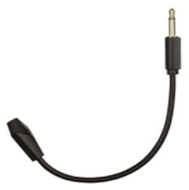
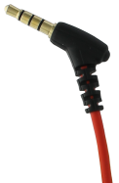
PC ACCESSORIES
Drakkar Kriger Earbuds + Microphone
Earbuds with a removable microphone
Main specifications:
Comfortable in-ear buds for optimal noise isolation
High quality sound
Ideal for smartphone
In-line microphone remote control which allows to receive incoming calls
Second pluggable microphone for gaming
Extra jack adapter to plug on PC
Carrying case
Technical specifications
Material | Silicon
Speakers dimension | 10 mm
Impedance | 16Ω
Microphone Sensitivity | 108dB
Frequency | 20Hz-20kHz
Cable length | 1,2m
Plug jack microphone | 3,5mm
Ref Innelec : 61881105092 Gencod : 3328170272834 Deee : 0,04 €
PVPC* : 29,99 €
 | Weight (kg) | Length (mm) | Width (mm) | Height (mm) | Quantity (pcs)
Unité |  |  |  |  | 1
Sous PCB
Master PCB
*Prix de vente public conseillé

