Slide 1
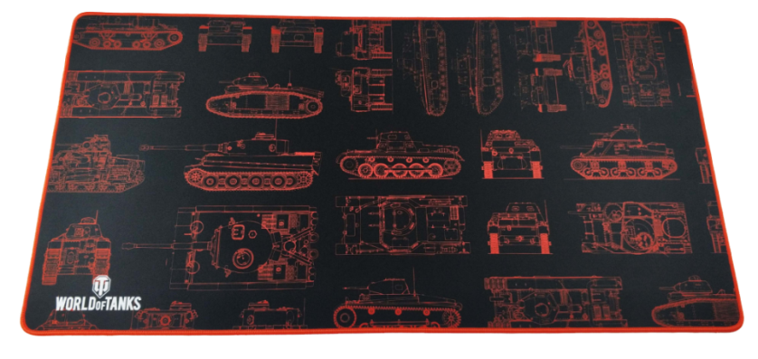
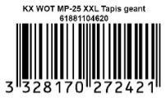
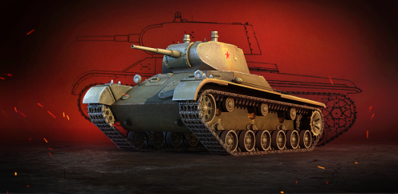
A gaming mousepad designed for gamers, affordable and of quality.
Technical specifications:
The mousepad is printed in a style inspired by Battlefield of the tank
Quality conception: The mousepad has been designed with gaming in mind: the extra smooth surface allows for a precise movement of the mouse. The reverse side is made from rubber with a maximal adherence to the desk surface.
The edges are blanket stitch
XXL Office Size : 900*460*3mm
The success of World Of Tanks!
World of Tanks also known as WOT is a massively multiplayer online game which was released in 2011, edited by Wargaming and gather more than 45 million registered players. It is a war simulation game in which you can control your own tank. In 2017 World of Tanks won its 3rd Golden Joystick, gaining the most votes in the “Still Playing” category thanks to their passionate and massive community of devoted players.
Konix in partnership with Wargaming is pleased to offer you the following bonuses:
For new players :
T-127 tank + garage slot + 7 days of premium account
For existing players:
1 day of premium account
Ref Innelec :61881104620
Barcode : 3328170272421
Deee : 0,00
PVTTC : 24.99€
 | Weight (kg) | Length (mm) | Width (mm) | Height (mm) | Quantity (pcs)
Unit |  |  |  |  | 1
Inner PCB
Master PCB

