Slide 1
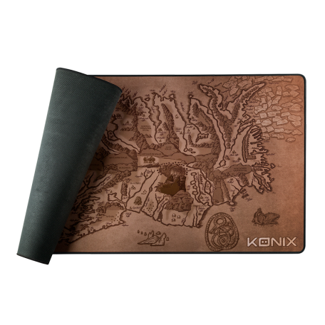
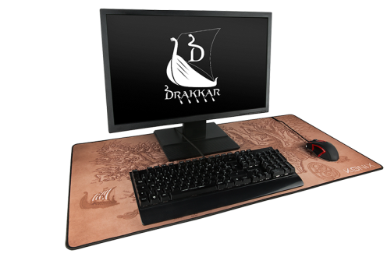
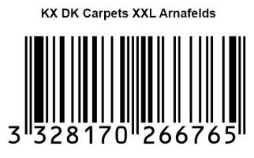
ACCESSOIRES PC
Drakkar Arnafelds
Technical specifications:
- Non-slip rubber base
- Textured surface for perfect glide
- XXL Office Size : 900x460mm
- Comfort and precision thanks to 3mm thickness
- Strong anti-fraying contours
- Illustration Viking "The world of Drakkar"
Ref Innelec : 61881100799
Gencod : 3328170266765
Prix public généralement constaté : 24,99 €
 | Weight (kg) | Length (mm) | Width (mm) | Height (mm) | Quantity (pcs)
Unit
Inner carton
Master carton
PRIX PUBLIC CONSEILLÉ
29,99€

