Slide 1
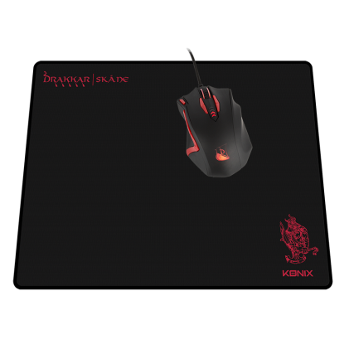
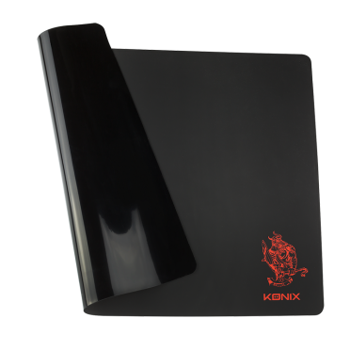
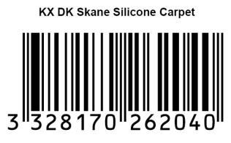
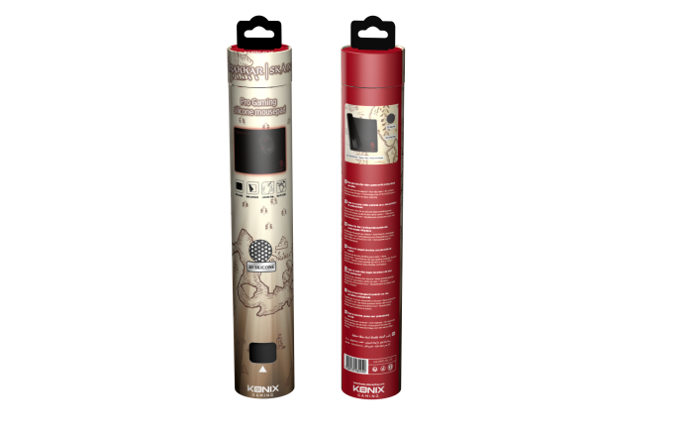
PC ACCESSOIRIES
Drakkar Skåne
Technical specifications:
- Ultra-thin silicon mousepad
- Non-slip base for a steady platform
- 3D surface limiting mouse friction for better gaming precision
- Extra-large size of 400x300x1mm for unlimited moves during the game
- Protective coating for an easy cleaning
Ref Innelec : 61881197828
Gencod : 3328170262040
Deee : 0,00 €
Recommended public price : 19,99 €
 | Weight (kg) | Length (mm) | Width (mm) | Height (mm) | Quantity (pcs)
Unit | 0,18 | 300 | 50 | 50 | 1
Inner PCB
Master PCB
PRIX PUBLIC CONSEILLÉ
29,99€
Visuel non définitif

