Slide 1
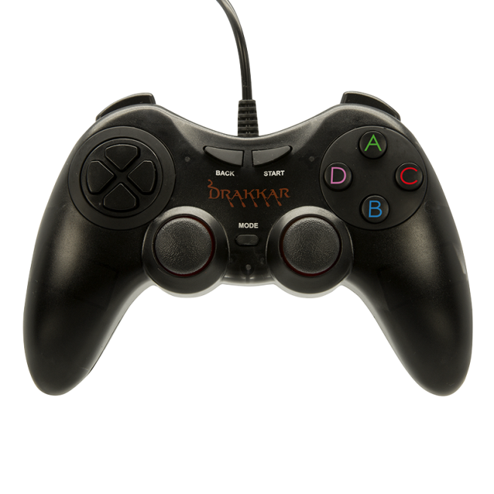
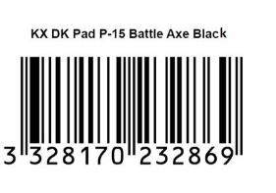
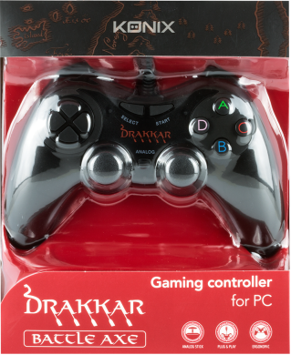
ACCESSOIRES PC
Drakkar Battle Axe
Technical specifications:
Drakkar gamepad is ideal for platform, action-adventure, sport or arcade games.
Ergonomic Design : Comfortable grip with anti-slip texture and quick access to all functions .
Optimized buttons: Digital Action Buttons intuitive access , 2 joysticks with rubber texture , D -pad with individual buttons for better accuracy
Plug & Play connection: USB plug and play
Cable length 1,8 m
Ref Innelec : 61881180544
Gencod : 3328170232869
Deee : 0,17 €
RPP : 12,99€
 | Weight (kg) | Length (mm) | Width (mm) | Height (mm) | Quantity (pcs)
Unit | 0,38 | 170 | 52 | 220 | 1
Inner carton | 1,51 | 185 | 220 | 245 | 4
Master carton | 9,1 | 570 | 235 | 515 | 24

