Slide 1
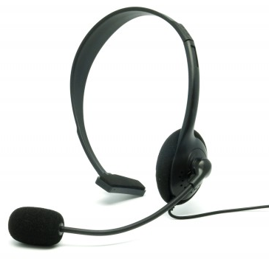
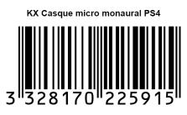
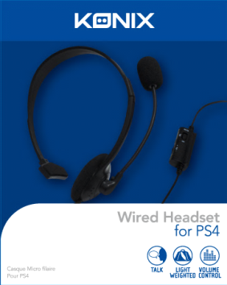
PS4 ACCESSORIES
Wired headset for PS4
Communicate with other PSN players!
Technical specifications:
Comfortable monaural headset
Plugs directly to your PS4 controller
Volume control on the switch and adjustable microphone
Anti-noise micro, light and comfortable
Ref Innelec : 61881177082
Barcode : 3328170225915
Deee : 0,08 €
Recommended public price : 9,99 €
 | Weight (kg) | Length (mm) | Width (mm) | Height (mm) | Quantity (pcs)
Unit | 0.09 | 135 | 55 | 195 | 1
Inner carton
Master carton | 2.4 | 333 | 261 | 277 | 20

